Slide 1
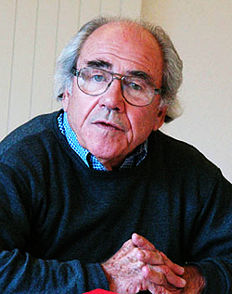
Jean Baudrillard
(1929-2007)

Slide 2
Introduction
He was a French sociologist, philosopher, cultural theorist, political commentator, and photographer.
Born in Reims, north-eastern France, on July 27, 1929.
During his high school studies he came into contact with pataphysics.
He started his academic life as a Marxist sociologist.
Slowly dissatisfied with Marxism, he went on to incorporate structuralism and semiology into his analysis.
Sign exchange value.

Slide 3
In the 1980s and 90s, Baudrillard turned to post-structuralism.
In the postmodern media-laden condition, we experience something called "the death of the real": we live our lives in the realm of hyper reality.
Baudrillard believes hyper reality involves creating a symbol or set of signifiers which actually represent something that does not actually exist like Santa Claus.

Slide 4
Simulacra and Simulation
Baudrillard incorporated structuralism and semiology into his analysis, seeing the objects we consume as a system of signs that had to be decoded.
He wrote the book Simulacra and Simulation seeking to integrate reality, symbols/signs and society.
He claims that our current society has replaced all reality and meaning with symbols and signs, and that human experience is a simulation of reality.

Slide 5
Simulacra and Simulation
Simulacra are copies without the substance or qualities of the original.
Simulation is the active process of replacement of the real
The simulacra that Baudrillard refers to are the significations and symbolism of culture and media that construct perceived reality, the acquired understanding by which our lives and shared existence are rendered legible.
Baudrillard believed that society has become so saturated with these simulacra and our lives so saturated with the constructs of society that all meaning was being rendered meaningless by being infinitely mutable. He called this phenomenon the "precession of simulacra".

Slide 6
Phases of the Image
The first stage is a faithful image/copy of the original, where we believe, that a sign is a "reflection of a profound reality". The image is a good appearance, Baudrillard calls this “ the sacramental order ".
The second stage is perversion of reality, this is where we come to believe the sign to be an unfaithful copy, which "masks and denatures" reality as an evil appearance—it is of "the order of maleficence". Here, signs and images do not faithfully reveal reality to us, but can hint at the existence of an uncertain reality.

Slide 7
Phases of the Image
The third stage masks the absence of a profound reality, where the simulacrum pretends to be a faithful copy, but it is a copy with no original qualities. Signs and images claim to represent something real, but no representation is taking place. He calls this "the order of sorcery".
The fourth stage is pure simulation, in which the simulacrum has no relationship to any reality whatsoever. Here, signs merely reflect other signs. Any claim to reality on the part of images or signs is only of the order of other such claims.

Slide 8
In real life
“We live in an age of simulacra” (J. Baudrillard), a world within which exists simulations upon simulations, copies of copies of copies.”
what has happened in postmodern culture is that our society has become so reliant on models and maps that we have lost all contact with the real world that preceded the map

Slide 9
Media and Internet
Media as television, film and the internet are compromising that which is real and replacing it with images that are “hyperreal” (J. Baudrillard), not really real, nor signs of reality, but simulacra.

Slide 10

Christmas Tree
The plastic christmas tree many people buy every year is also an example of hyperreality

Slide 11
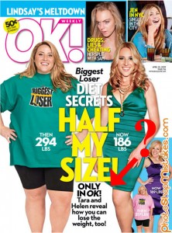
Magazine covers & Photoshop
Magazine covers that use a lot of Photoshop techniques work as a simulacrum as they are copies of a real person

Slide 12
Orders of simulacra
First order-place marker for the real
Second order-distinction between reality and representation is blurred
Third order-simulation precedes reality
Image pertains to a reality that does not exist
Map-territory
Disneyland

Slide 13
HYPERREALITY AND PRECESSION OF SIMULACRA

Slide 14
Hyperreality
Baudrillard defined "hyperreality" as "the generation by models of a real without origin or reality
It is a representation, a sign, without an original referent.
It is not blending the 'real' with the symbol which represents it
Involves creating a symbol which actually represent something that does not actually exist eg santa claus
We live in a world where there is more and more information, and less and less meaning
Something which turns out to be unreal which you thought to be real

Slide 15
Disneyland
Purpose of Disneyland is not to be a place to behave child like it is to hide the fact that we are all childish and not adults
“This world wants to be childish in order to make us believe that the adults are elsewhere, in the "real" world, and to conceal the fact that true childishness is everywhere - that it is that of the adults themselves who come here to act the child in order to foster illusions as to their real childishness”

Slide 16
Gulf war and Holocaust
Television news, not only reports about important events
It makes events important by reporting about them. The fighting "did not really take place" from the point of view of the west.
The media presentations made it impossible to distinguish between the experience of what truly happened in the conflict,
It is selective misrepresentation through --simulacra
Matrix movie

Slide 17
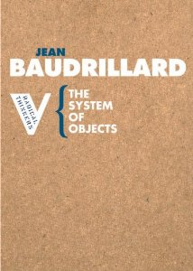
The Object Value System

Slide 18
The System of Objects, The Mirror of Production
Differed from Marx in one significant way: consumption, rather than
production, the main drive in capitalist society.
Criticized Marx's concept of "use-value”. Needs→Use
On consumerism and how different objects(represent much more than mere utility) are consumed
Needs are constructed, rather than innate.
"ideological genesis of needs" precedes the production of goods to meet those needs.

Slide 19

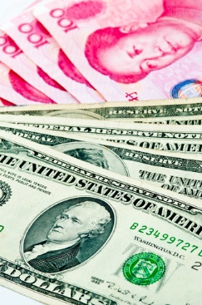
Functional value
An object gains its value from being used in a
productive manner or serving a purpose
Exchange value
An object derives its value from its economic value

Slide 20
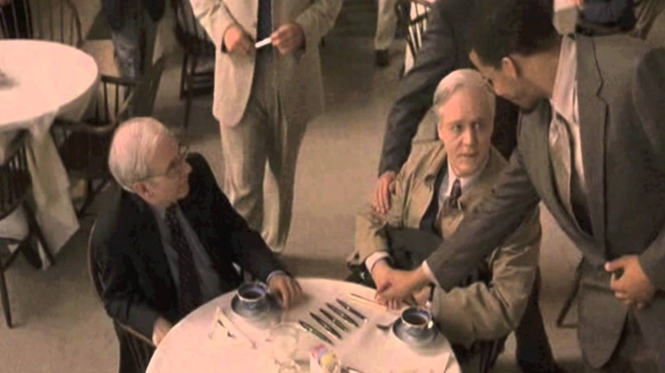
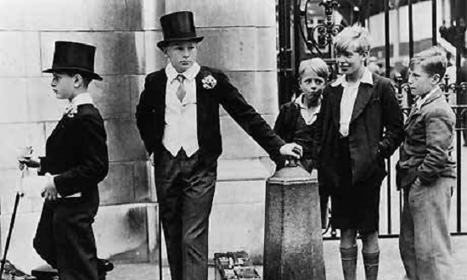
Symbolic value
An object is assigned a value, by a subject, in relation to another subject
Sign value
The value of an object within a system of objects

Slide 21
“Our society thinks itself and speaks itself as a consumer society. As much as it consumes anything, it consumes itself as consumer society, as idea. Advertising is the triumphal paean to that idea”
All reality is filtered through the logic of exchange value and advertising

Slide 22
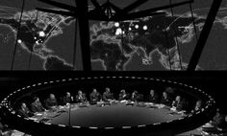
The end of History and meaning
Baudrillard's most common theme was historicity [1980’s]
Agreed with Francis Fukuyama that History had ended with the spread of globalization
Baudrillard affirmed that this end should not be understood as the culmination of history's progress, but as the collapse of the very idea of historical progress
“We have the particle accelerator [ globalization] that has smashed the referential orbit of things [ idea of communism ] once and for all”
Argued that the end of the Cold War was not caused by one ideology's victory over the other, but the disappearance of the utopian visions that both the political Right and Left shared

Slide 23
The end of history is, alas, also the end of the dustbins of history. There are no longer any dustbins for disposing of old ideologies, old regimes, old values. Where are we going to throw Marxism, which actually invented the dustbins of history? (Yet there is some justice here since the very people who invented them have fallen in.) Conclusion: if there are no more dustbins of history, this is because History itself has become a dustbin. It has become its own dustbin, just as the planet itself is becoming its own dustbin
Found some affinity with the postmodern philosophy of Jean-François Lyotard, who famously argued that in the late 20th century there was no longer any room for “metanarratives”
In his book The Illusion of the End , he argued the Marxist visions of global communism were themselves nothing more than a misguided thoughts
Universality was still a notion utilized in world politics as an excuse for actions

